Slide 1

Creativity Matters
Creative Careers Pathways

Slide 2






CREATIVITY MATTERS: WHY?
CREATIVITY AND THE WORKPLACE
The Overview
CREATIVITY AND ME
WHAT VALUE DOES CREATIVITY HAVE?

Slide 3
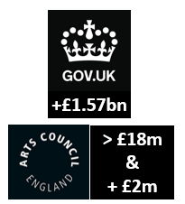

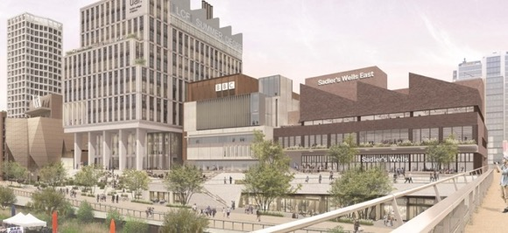
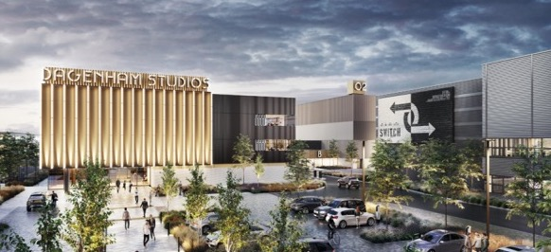
Re-Cap
CREATIVITY MATTERS: WHY?
CREATIVITY AND ME
ONE OF THE TOP 3 MOST DESIRABLE SKILLS FOR FUTURE JOBS
SECTOR and INDUSTRY INVESTMENT AND FUNDING
Growth – Choice- Talent
”Creativity is the act of turning new and imaginative ideas into reality”
Creativityatwork.com
FUTURE LEARING OPPORTUNITIES AND JOBS
East Bank
Dagenham Studios
Digital and Creative have been the fastest growing sector in Waltham Forest

Slide 4
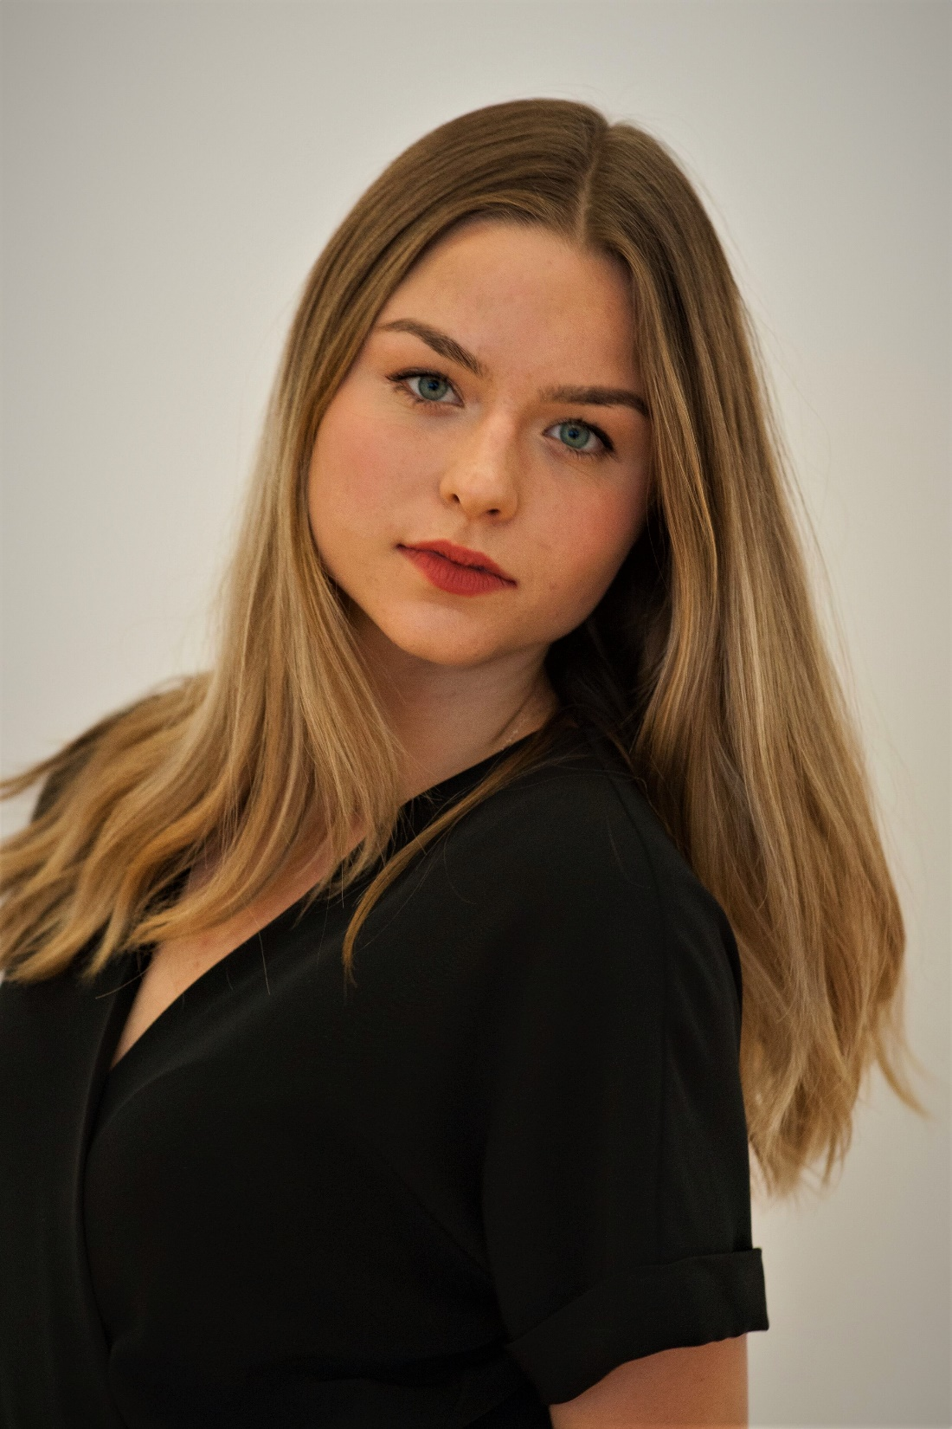



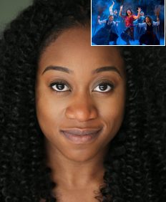

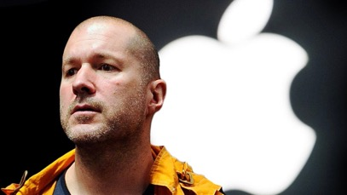
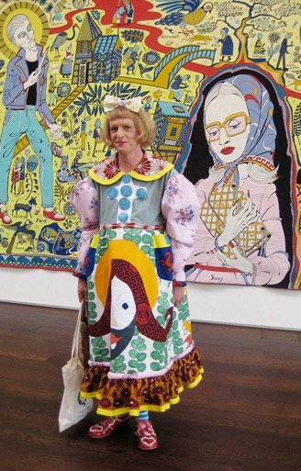



Today’s Session
Local Success Stories: People, Business, Location
Education Routes
Professional Pathways
Steps you can take to create a creative pathway
Notes:
Home Grown Talent and Business Success Stories
Waltham Forest College:
Leyton Sixth Form College:
Monoux Sixth Form College:
Future Creatives: Waltham Forest trainees to become the next generation of leaders in the creative world
BCE: The largest creative college in London

Slide 5
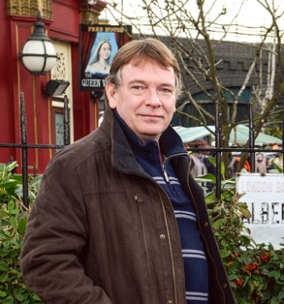

Success: Local People
Notes:
Waltham Forest Alumni
Actor: Adam Woodyatt (Ian from Eastenders) Went to Forest School
Writer and broadcaster: June Sarpong (BBC's first Director of Creative Diversity)
Designer: Jonathan Ive (former Chief Design Officer of Apple Inc) went to Chingford Foundation School
Artist: Grayson Perry (creator of The Walthamstow Tapestry- had studio in Walthamstow)
Musician: Lethal Bizzel (Grime artist) Attended Holy Family Catholic School in Walthamstow

Slide 6
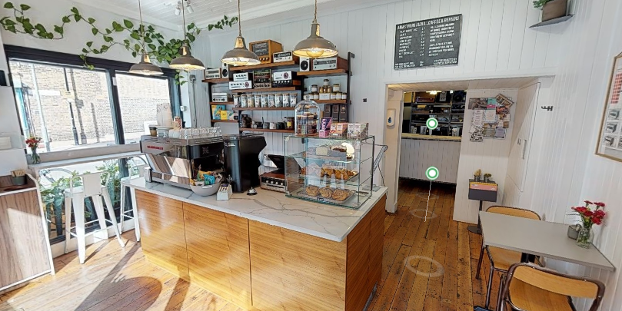
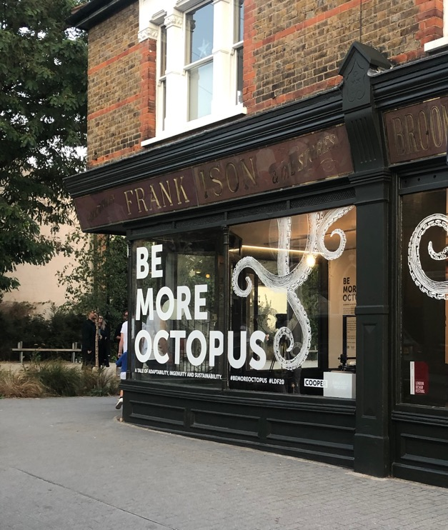
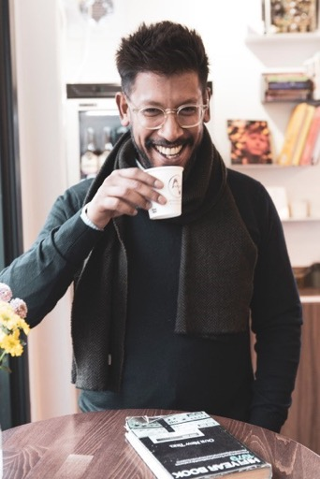
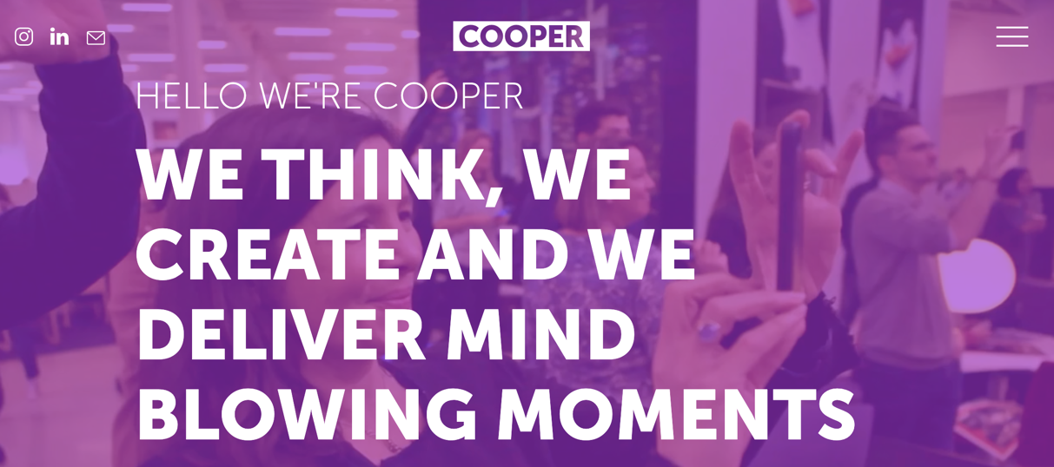

Success: Local Business
Sir Richard Branson has a mantra that runs through the DNA of Virgin companies.
The mantra is A-B-C-D.
Always
Be
Connecting the
Dots.
(Creativityatwork.com 2021)
"A craftsman's approach to repairs"
(Armstrong Audio 2021)
https://www.armstrong-audio.com/
Notes:
Armstrong Audio: A long-established electronic workshop with a history in manufacturing and even more experience in servicing and restoring audio equipment. Armstrong Audio is able to repair a wide-range of audio equipment and a variety of faults, so before you decide to replace your beloved
Be more octopus: Be adaptable. Be ingenious. Be compassionate.
https://cooper-collective.com/projects/be-more-octopus
Octopus are one of the most adaptable and intelligent creatures on the planet.
creative agency Cooper Collective created the Sky Ocean Rescue Café - the UK’s first café made completely from recycled and ocean sourced materials, they learned, adapted and put sustainability at the heart of their experiential and environmental creative thinking.
their sustainable approach to environmental design
engaging guests with a surprise deep sea AR experience
They exhibited in Walthamstow in Sep 20
All parts of the exhibit have been created from sustainable sources and will be upcycled post event to ensure waste is negated. Wall panels will become tote bags and face masks, whilst the 3D printed coral reef (made from recycled plastic) will go to a marine centre where it will be embedded into the aquarium for the marine life to enjoy.

Slide 7
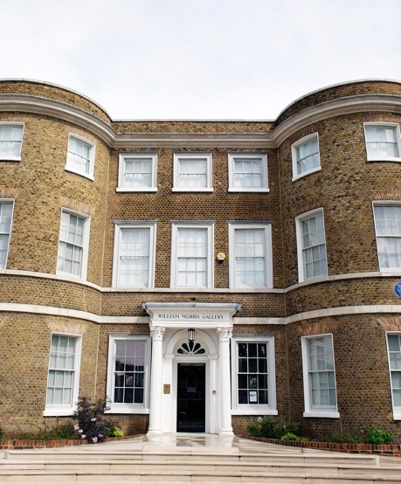
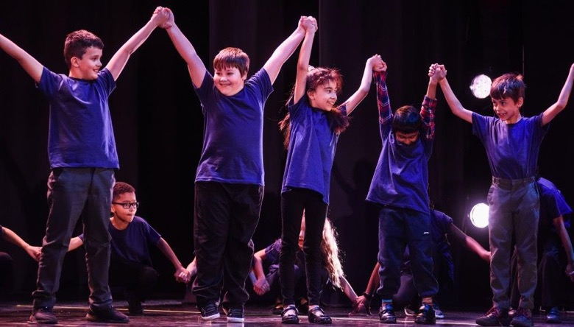

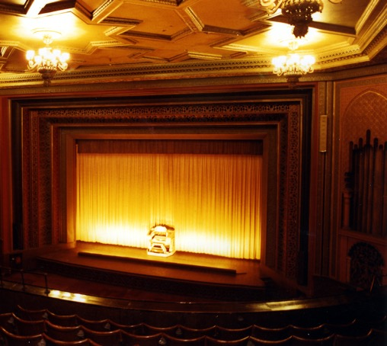
Success: Local Area
Waltham Forest: A cultural success story
Waltham Forest has shown fastest employment growth in London (30% compared to London average of 14%)
Digital and Creative has been fastest growing sector in Waltham Forest (40% over 5 years; exceeding
construction,
and retail)
Borough increasingly known as a centre of culture and creativity

Slide 8

Creative Careers: Pathways
Education Route
Academic
Technical
Specialist Provision
Classroom
Practical
Blended
Learning Environment
Sixth Form School
Sixth Form College
College
Familiar or New Start
Facilities
Campus
Learning Level
16+
Entry to Level 3
18+
Entry to Level 3
Level 4 upwards
Criteria & Results
Experience/ Portfolio
Learning Needs
CHOOSING A CREATIVE LEARNING PATHWAY

Slide 9
Local Further Education
Schools with sixth forms in Waltham Forest
Chingford Foundation School
Heathcote School & Science College
Highams Park School
Holy Family Catholic School
Kelmscott School
Lammas School & Sixth Form
Norlington School & 6th Form
Walthamstow Academy
To find out what courses are offered by each school it is best to look at the school’s own website and view their course programme/prospectus.
Details about Special Schools can be found on the special schools webpage.
Further education colleges and sixth form colleges in Waltham Forest
Big Creative Education Academy
Leyton Sixth Form College
Sir George Monoux College
Waltham Forest College

Slide 10




Big Creative Education (College)
WATCH this 3m30s Careers Video
Bringing Industry to the Classroom
Careers at Big Creative Education provide a dedicated two year programme to help you kick-start you creative career
WATCH this 2minute video about Apprenticeships at BCE - Learn Earn Succeed

Slide 11



Big Creative Education

Slide 12
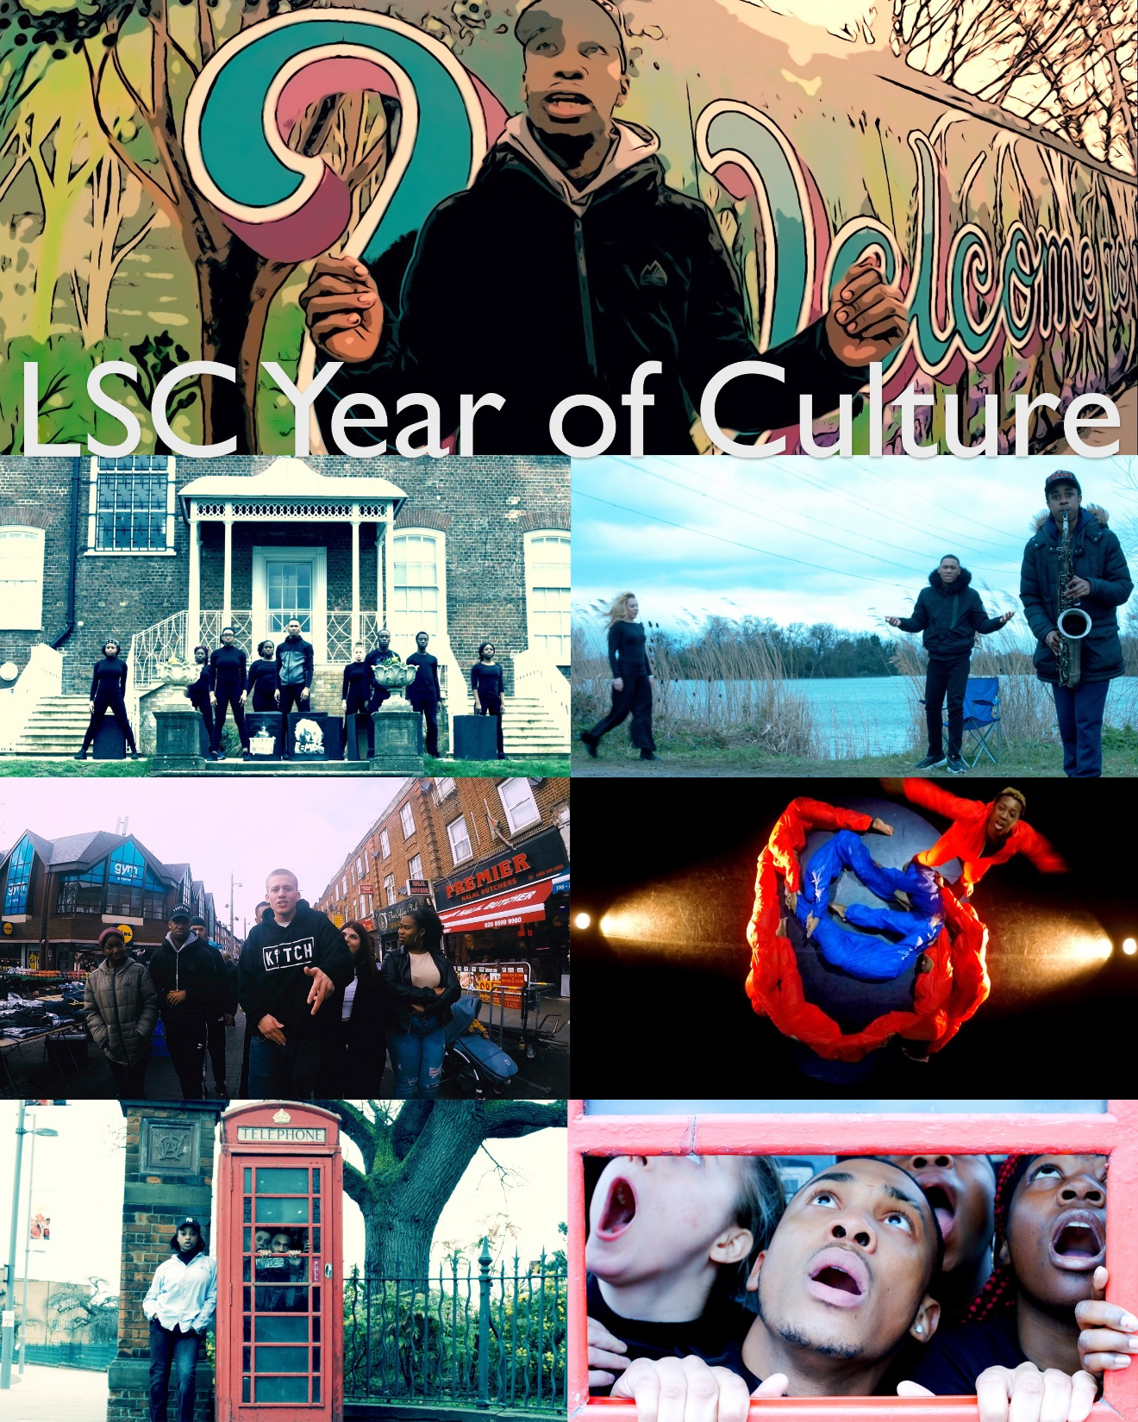

Leyton Sixth Form College
An inclusive 16-19 year old educational establishment with circa 2300 students each year
With a very wide range of enrichment opportunities and specialist facilities for all of our courses
http://www.leyton.ac.uk
A Levels:
Film Studies, Media Studies, Fine Art, Art and Architecture, Textiles, Graphic Design, Photography
BTEC L3 Extended Certificates (One A Level equivalent):
Music, Dance, Acting, Photography
UAL Awarding Body Extended Diplomas (3 A Level equivalent):
Performing Arts, Music, Media Production and Art and Design
UAL Awarding Body L2 Diplomas (4 GCSE’s):
Performing Arts, Creative Media and Art and Design
LSC Expressive Arts website
Media Leyton YouTube Channel:
Leyton Live (Music) YouTube Channel
Lock Down devised play exploring youth violence
Cuffed dance performance film exploring girl gangs
Outside the Box a cross-creative arts project that LSC produced for
Year of Culture

Slide 13
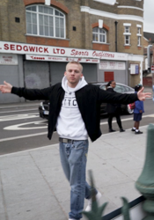
Leyton Sixth Form College
Discover the possibilities of studying on a creative programme
Alumni at LSC have had varied learning pathways and careers success
MARTA - LSC Alumni
1st Class Honours Degree Middlesex University
Now a choreographer and dancer for music videos and TV Extra
KITCH - LSC Alumni
Distinction in UAL Diploma in Music
Followed by BBCs Ouch Team as he rehearsed at LSC in preparation of Performing at events, in competitions
VIEW More
LSC Alumni
ISLAM
NAO
RICARDO
RAZIYE
FARIHAH
CALLY
CONSUELA - LSC Alumni
Won a Full Scholarship to study BA Musical Theatre at Mountview
Has been in various UK productions, on a European Tour, with her WestEnd Debut being Enid in the Worst Witch in Summer 2019

Slide 14

Sir George Monoux
Sixth Form College
https://www.sgmc.ac.uk/
@MonouXcollege
Event Name | Event Description | Date and Time | Useful URLs
Monoux Mondays | Attend these free application sessions via zoom for advice on applying to SGMC. | Every Monday 14:00-15:00 | Email: anam.ali@sgmc.ac.uk
Open Evening | Visit the college to ask your course related questions, have a tour and take part in interactive activities across all of our pathways. A great evening for course information and general enquiries. | Tuesday 23rd March 2021 16:00-19:00 | Book
Prospectus | View the 2021 prospectus online or request a copy. | n/a | Prospectus
Apply | Complete your application form online. |  | Apply

Slide 15


Waltham Forest College
myfuture@waltham.ac.uk
https://www.waltham.ac.uk/how-to-apply/application-process
Event Name | Event Description | Date and Time | Useful URLs
College Tours | Browse through our campus buildings using these videos, to get a closer insight into our dedicated vocational learning areas and facilities. Main Building, STEM Centre, Creative Industries, Hair, Beauty and Barbering, IT Room, Classrooms, Carpentry Workshop, Plumbing Workshop, Bricklaying Workshop, Machine Shop, Painting & Decorating Workshop, Princes Trust Team Programme. | In your own Time | Virtual Tour College Tours
Prospectus | Browse all full-time course possibilities for 2021/22 | n/a | Prospectus
Apply | Download, print, complete and submit an application form. | Admission Open | Apply

Slide 16



Local Higher Education
Hear from and WATCH 14 students share their
Insights to University of the Arts London
Located in the heart of London, UAL is Europe’s largest specialist art and design university.
Made up of 6 unique Colleges
London College of Communication Central Saint Martins
Chelsea College of Arts Camberwell College of Arts London College of Fashion Wimbledon College of Arts
Each College offers pre-degree, undergraduate and postgraduate courses in art, design, fashion, media, communication and performing arts.
Your creative future starts here.
Not even a pandemic stopped UAL Students celebrating and showcasing their talent!
2020 saw the students of University of the Arts London graduate without an end of year finale, instead IBM and UAL collaborated to host the entire student body of work into one showcase online
.
Watch the Graduate Showcase
and
View the graduates
collections.

Slide 17
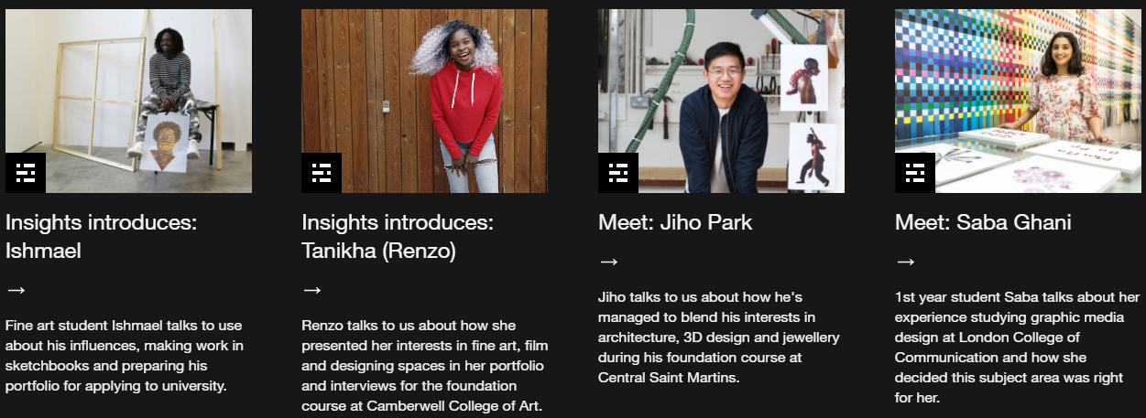

University of the Arts London
Learn from students about their experiences at London College of Fashion and Students journey into UAL
Read myth-busting learn about their life, work, processes, and graduation projects.
Browse subject areas and find what sparks your interest.
Want to understand more about
Fees? Finance? Funding?
Funding is available to some UAL students. This depends on the level of your course, subject area and fee status or nationality. Tuition fees vary depending on whether you are an international or Home/EU student.

Slide 18

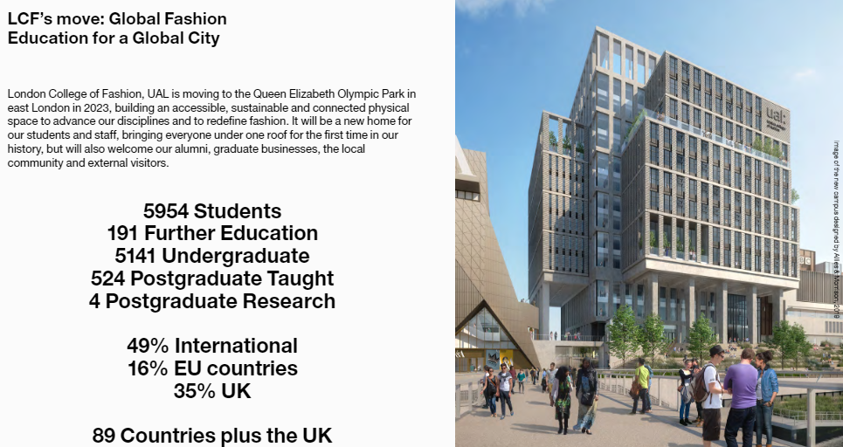
Looking Ahead…EAST BANK
London College of Fashion
are moving to the
Queen Elizabeth Olympic Park,
East Bank
Click here to learn about the range of courses available to enrol onto now.
East Bank

Slide 19

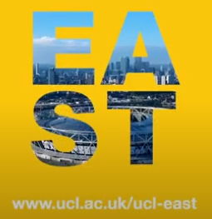

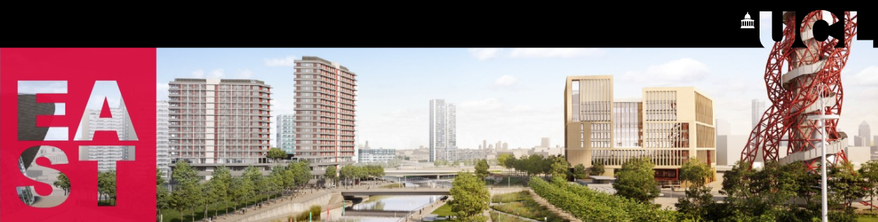
Looking Ahead…EAST BANK
EAST - The new campus is integrating Experiments, Arts, Society and Technology throughout its academic development.
Eight faculties – Phase 1 will bring together eight UCL faculties, with up to 4,000 students and around 260 academic staff.
Open to all – The ground and first floor of our buildings are designed to welcome in visitors and the public, as well as UCL staff and students.
‘EAST BANK is a new powerhouse of culture education and innovation’
Bringing together UCL academics, students, local communities and industry to solve the biggest challenges affecting people’s lives and the planet – today and into the future.
'A natural next step in our ambitious vision'
WATCH –the build develop and learn more about the UCL vision

Slide 20



How could you demonstrate that you are creative?

Slide 21












Next Steps
Research
How can your school help?
What support do universities offer?
Which companies would you like to work for?
Do they run traineeships or graduate schemes?
What does being self-employed involve?
Find artists you are inspired by

Slide 22

Next Steps
The opportunities available to you as Londoners and residents of Waltham Forest exceed those of young people in other parts of the country- make the most of them!
Mentor
Seek out someone who has had the professional success you would like to have*.
Ask them questions about the decisions that have made.
Ask them for advice on making the right subject choices.
Utilise professional organisations, such as GEM.org.uk or networking sites such as LinkedIn.
* Ask for advice and support from your school / college before approaching a potential mentor.

Slide 23

Creativity Matters
Create Your Path…

