Slide 1
Creative Careers Resources:
Introduction
This presentation is part of a suite of learning resources developed by Waltham Forest CEP to support teachers and young people to explore creative career pathways. Launched as part of a Creative Careers week in October 2020, it was combined with both live and online presentations in 20 schools from local creatives about their personal career journey. Hear short versions of these here
This presentation can be copied and adapted for individual school use but each slide should retain a credit to the LBWF Cultural Education Partnership as the original creator

Slide 2
Creative Careers:
Why creativity matters to employers and YOU
Your future – a signpost to a creative career
This presentation can be copied and adapted for individual school use but each slide should retain a credit to the LBWF Cultural Education Partnership as the original creator

Slide 3

”Creativity is the act of turning new and imaginative ideas into reality”
Creativityatwork.com
How could you define creativity?
“Creativeness is the ability to see relationships where none exist.”
Thomas Disch, author, 334, (1974)
“Creativity is the process of bringing something new into being.”
Rollo May, The Courage to Create
Notes:
What does it mean to be creative?
Discussion: How could you prove you’re a creative person from the activities you currently do?
What are you passionate about? What are you good at?
Documenting your work- creating a visual CV
Just one definition: https://www.creativityatwork.com/2014/02/17/what-is-creativity/

Slide 4
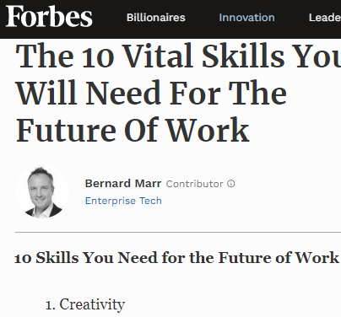
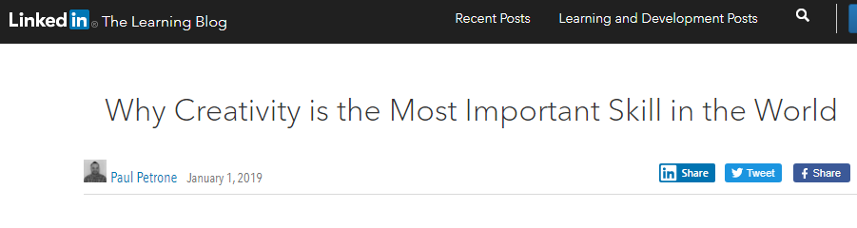
CREATIVITY REGULARLY NAMED BY EMPLOYERS AS ONE OF THE TOP 3 MOST DESIRABLE SKILLS FOR FUTURE JOBS
ABOUT 1 IN 8 UK BUSINESSES IS IN CREATIVE INDUSTRIES*
* Statistics from the Department of Digital, Culture, Media & Sport, (DCMS)

Slide 5
What are creative industries or workplaces?
Notes:
Eg. Music, Film and TV, traditional crafts…

Slide 6

Notes:
…and many more! Does the audience have any other good ones?
Now think about the individual job titles in each of these industries.

Slide 7


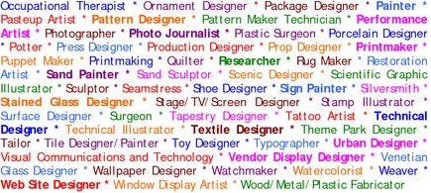
Notes:
Think about the difference between working in a creative industry and being creative in another sector.
You might be a marketing manager for a bank or an accountant for a theatre…
If you have time you can talk about all the different types of people you work with.
Or perhaps you can talk about your training and what the people you studied with went on to do with the same qualification.

Slide 8
Which ‘creative industry’ makes the most money?
Notes:
POP QUIZ: What do you think makes more money for the UK?
The music industry?
TV and Film?
Or IT software and games?

Slide 9
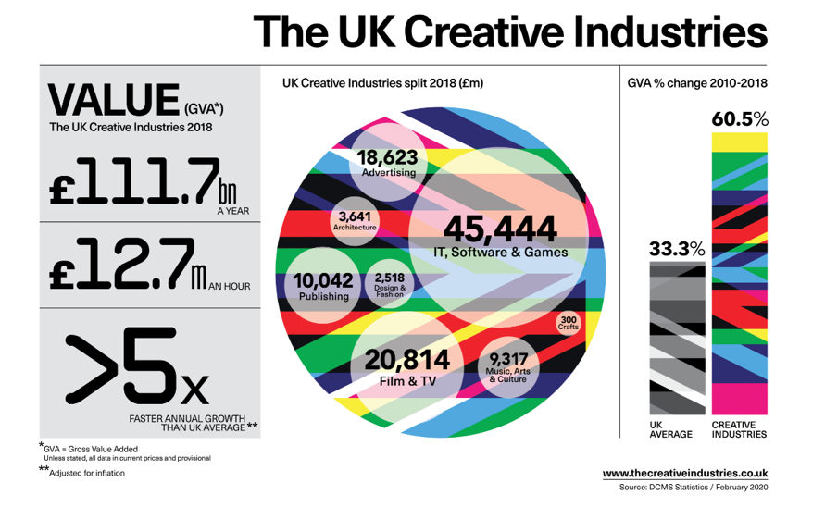
Notes:
The creative industries contribute £111.7 billion a year to the UK economy
That’s £12.7 million an hour!
£45,444 million is generated by the IT, Software and Games industries
£20,814 million is generated by Film and TV
2019 infographics should be available in June https://www.thecreativeindustries.co.uk/resources/infographics

Slide 10
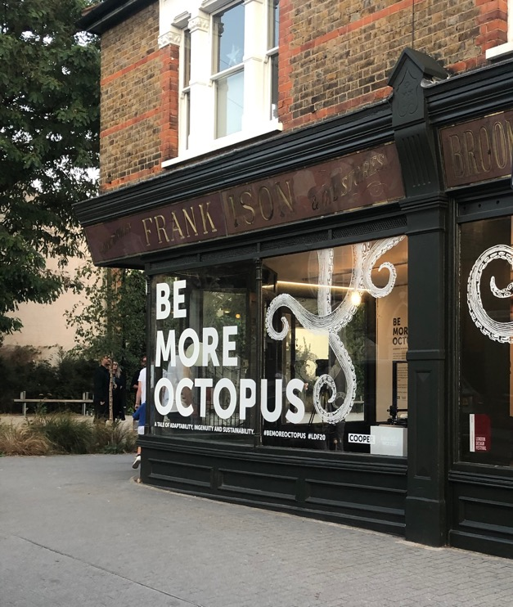
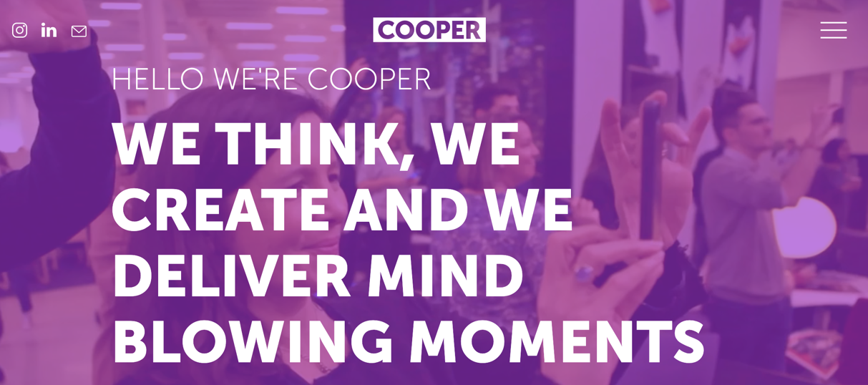
Notes:
Be more octopus
Octopus are one of the most adaptable and intelligent creatures on the planet.
After the creative agency Cooper Collective created the Sky Ocean Rescue Café - the UK’s first café made completely from recycled and ocean sourced materials, they learned, adapted and put sustainability at the heart of their experiential and environmental creative thinking.
They have a pop-up exhibition in Walthamstow until 15th September which showcases their sustainable approach to environmental design, whilst engaging guests with a surprise deep sea AR experience. All parts of the exhibit have been created from sustainable sources and will be upcycled post event to ensure waste is negated. Wall panels will become tote bags and face masks, whilst the 3D printed coral reef (made from recycled plastic) will go to a marine centre where it will be embedded into the aquarium for the marine life to enjoy.
“In this crisis rich world, there is no excuse for irresponsible approaches to production. We hope that Be More Octopus acts as an inspiration for people to seek out sustainable materials and production methods in their creative thinking.”
Be adaptable. Be ingenious. Be compassionate.
https://cooper-collective.com/projects/be-more-octopus

Slide 11
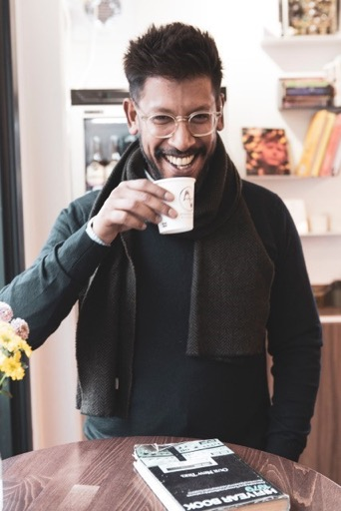
Armstrong Audio is a company that specialises in the repair and restoration of analogue audio equipment and also incorporates a coffee shop.
They have been located on Blackhorse Lane for 35+ years
Why do you think they have
survived for so long?
Notes:
Discuss- why do you think this business has survived so long?
What might they have they done to adapt?

Slide 12
Creative industries in Waltham Forest:
And neighbouring boroughs
Notes:
How could you prove that you’re a creative person from the activities you currently do?
What are you passionate about? What are you good at?

Slide 13

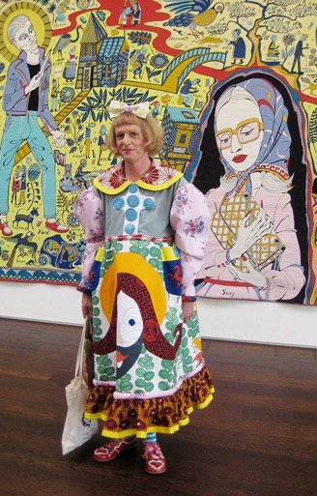
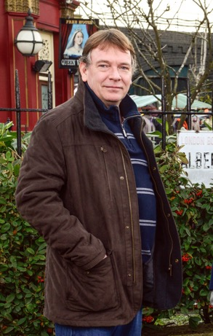

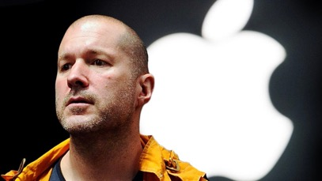
Famous Waltham Foresters
Notes:
Waltham Forest Alumni
Actor: Adam Woodyatt (Ian from Eastenders) Went to Forest School
Writer and broadcaster: June Sarpong (BBC's first Director of Creative Diversity)
Designer: Jonathan Ive (former Chief Design Officer of Apple Inc) went to Chingford Foundation School
Artist: Grayson Perry (creator of The Walthamstow Tapestry- had studio in Walthamstow)
Musician: Lethal Bizzel (Grime artist) Attended Holy Family Catholic School in Walthamstow

Slide 14
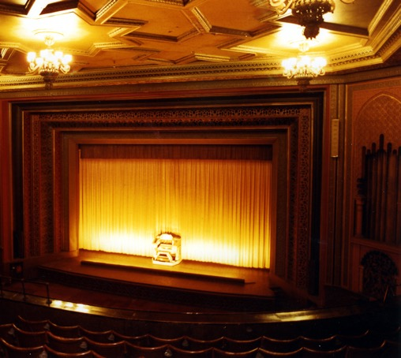
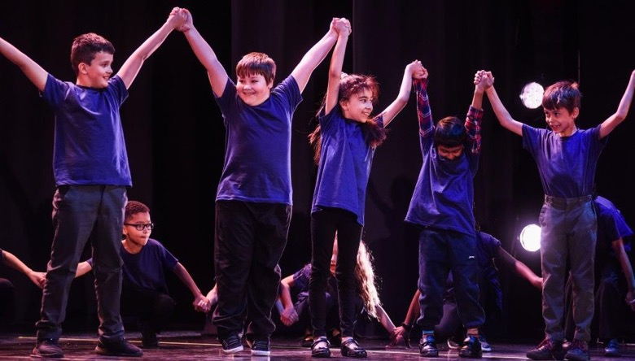
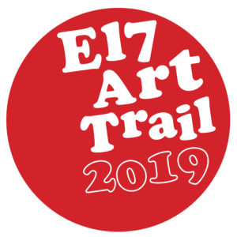
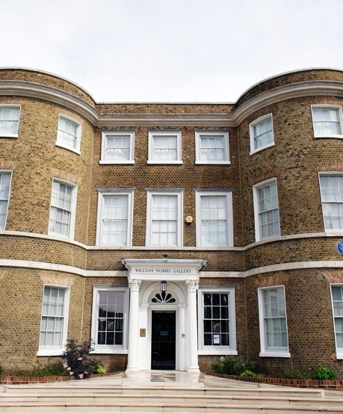
Waltham Forest:
A cultural success story
Notes:
Borough increasingly known as a centre of culture and creativity
E17 Art Trail (biggest independent Art trail in Uk)
Borough of culture 2019 – New Adventures residency at Roger Ascham school
Soho theatre coming to EMD
William Morris Gallery; (redeveloped 2012)

Slide 15
Creative Industries in Waltham Forest…
Waltham Forest has shown fastest employment growth in London (30% compared to London average of 14%)
Digital and Creative has been fastest growing sector in Waltham Forest (40% over 5 years; exceeding construction, and retail)
Notes:
source: https://www.walthamforest.gov.uk/sites/default/files/Economic_Growth_Strategy_Report_2016_20_0.pdf

Slide 16
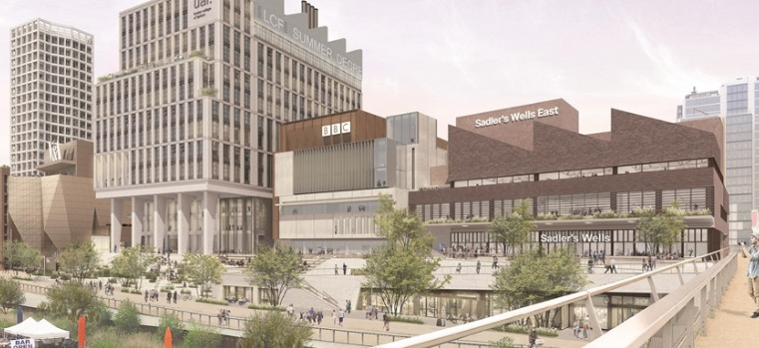

The growth of Creative Industries in
neighbouring boroughs
EAST BANK - Stratford
Dagenham studios – barking & dagenham
Notes:
East Bank will bring an additional 1.5 million visitors to the Park and surrounding area each year
More than 2,500 jobs will be created in East Bank, and an estimated £1.5 billion generation for the local economy
Sadler's Wells East will open a 550-seat theatre and establish a new centre for choreographic practice and a hip hop academy, both of which will be the first of their kind in the country
UAL's London College of Fashion will integrate its six sites onto one campus, accommodating 6,500 students with their world-leading research community, business incubation and social enterpise centres
V&A East will display its world-famous collections at two sites with a new museum at Stratford Waterfront and the V&A Collection and Research at Here East
The Smithsonian Institution will establish a presence in London for the first time ever, in partnership with the V&A
The state of the art BBC music studios will provide a hub from which to celebrate music of all genres
UCL will create a new campus, UCL East, providing multi-disciplinary research, teaching and innovation, in areas such as robotics, smart cities, culture and conservation, for around 4,000 students
DAGENHAM STUDIOS
Planning is underway for new state-of-the-art facility for film and TV production The planned studios will feature six sound stages covering 140,000 sq. ft., 85,200 sq. ft. of offices and 174,500 sq. ft. of workshops.
https://variety.com/2020/artisans/news/dagenham-studios-1203525920/

Slide 17
Case Studies
These case studies from Leyton Sixth Form College represent a snapshot of the possibilities available to students studying on a creative programme.
Case studies include students from traditional A Level programmes, vocational education and those that have travelled a long way from L1 onwards.

Slide 18

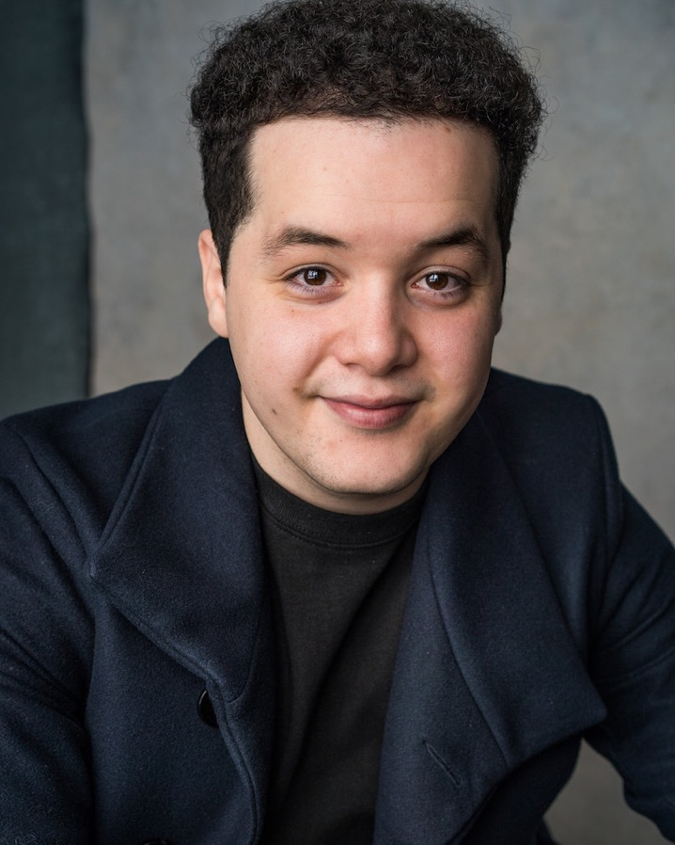
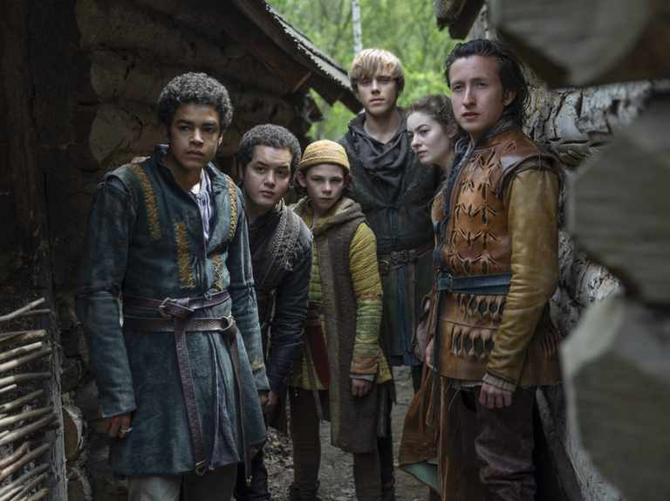
Islam
Islam graduated from LSC in 2015 and went on to study BA Acting at Arts Educational in West London - known mainly for their Film and Television training.
Islam has since gone on to sign with the prestigious talent agency 'Independent Talent' and made his theatre debut in the Shakespearean adaptation of 'Queen Margaret' at the Royal Exchange in 2018.
Since then, Islam has made his TV debut with Netflix - appearing in Ricky Gervais' 'Afterlife' in 2019 and starring in the fantasy series 'The Letter for the King' in March of this year.

Slide 19

Nao
Nao graduated from LSC with a DDD in her BTEC L3 Extended Diploma in Music.
She went on to study jazz singing at Guildhall School of Music and Drama for four years.
In 2014 shee was identified as one of the best upcoming talents by BBC 1XTRA and was nominated for MOBO in 2015
She has gone onto to establish herself as a successful artist. She has released two acclaimed albums, performed internationally and appeared at Glastonbury

Slide 20
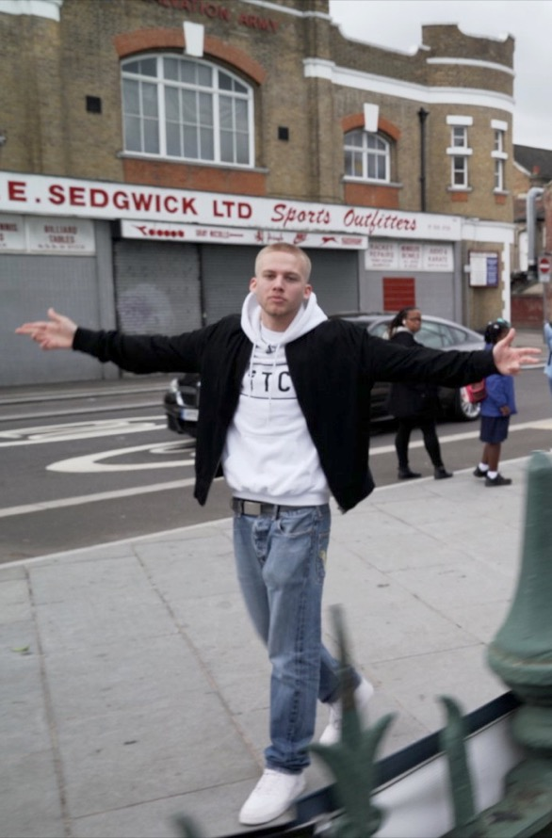
Kitch
Kitch graduated from LSC last year with a Distinction in his UAL Awarding Body Diploma in Music and is currently studying music at Goldsmith University.
Kitch has already establishing himself in East London as a name to watch with his blend of quick fire rhymes and meaningful messages.
He has performed at a range of events including Chingfest and The battle of the Bands organised by Damon Albarn during Year of Culture.
He became best known for his autobiographical track Miracle about coping with a stammer at the same time as making the journey to become a rap artist. His story was picked up by the BBC’s Ouch team who followed him as he rehearsed at LSC in preparation for his performance at London’s HighTide Festival.

Slide 21
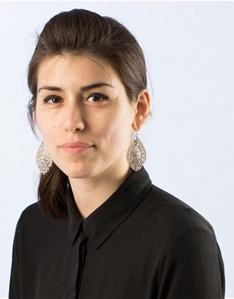
Raziye
Raziye graduated from LSC with three A Levels in Media Studies, French and English.
Studied at Sussex University, then Goldsmiths, got awarded a Scott Trust bursary from The Guardian to study her MA in journalism.
Worked for the Guardian (features) and the Telegraph, and is now the Turkey correspondent for AFP news agency, and founder of @Turkeyrecap.

Slide 22
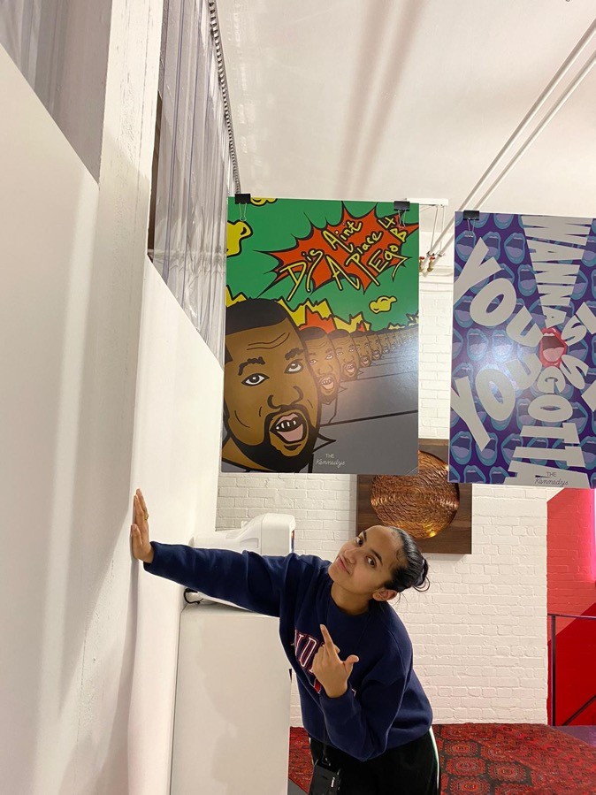
Farihah
Farihah graduated from LSC in 2019 with A Levels in Media Studies, Photography and Sociology.
Whilst at LSC she completed a pre-internship programme with advertising Agency Wieden + Kennedy and as a result won a paid two week internship over the summer holiday.
Following this she was accepted from over 130, mainly graduate, applicants to do a W+K paid apprenticeship for six months.
She is now starting a degree in Fashion Communication and Styling whilst being mentored.

Slide 23
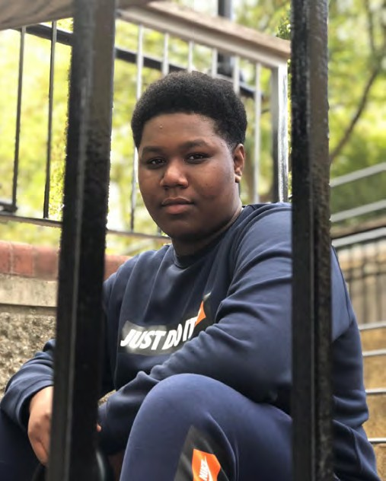

Rohan
I’m pursuing my dreams…
I went to an afterschool club, which inspired me. Their funding was cut and there was nowhere for me to produce music and develop my talent.
On the NXT CREATIVES programme I have become more confident, I have learnt networking skills and I am now certain that I have made the right decision to pursue my dreams and not get stuck in a job that I don’t want to do.

Slide 24
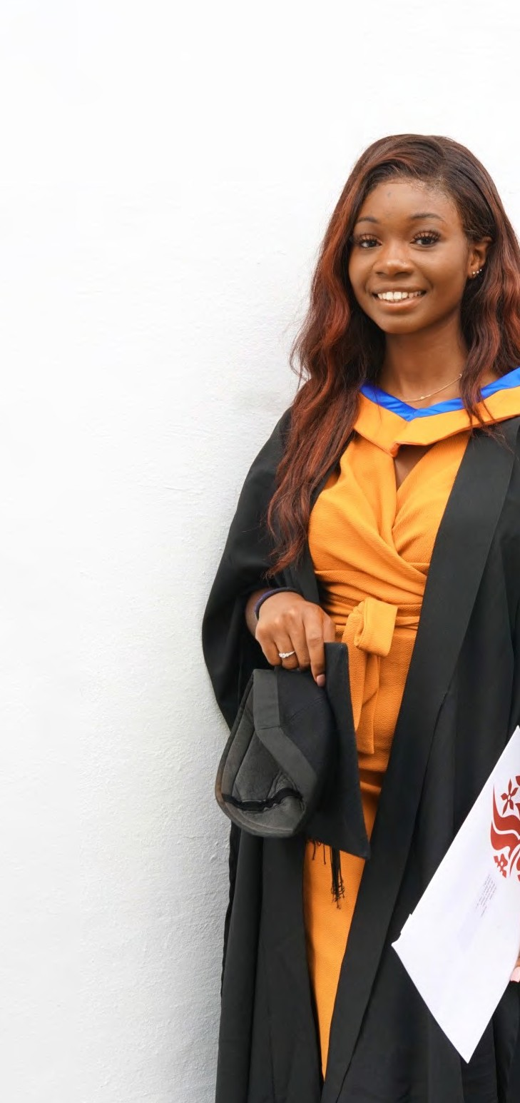
Miriam
I got experience to add to my CV…
Since I’ve left BCE a lot has happened – I have just finished my BA degree in an Interior Architectural / Design firm. I also draw hyper-realistic portraits on the side.
A lot of skills I’ve learnt studying Fashion at BCE really helped me when I was in university. The work experience that was offered to me like the London Fashion Week, Etta Bond video shoot, and Wesley Harriot Fashion Assistant helped me grow by taking me out of my comfort zone and gave me experience to add to my CV. It was the beginning of my creative career.

Slide 25
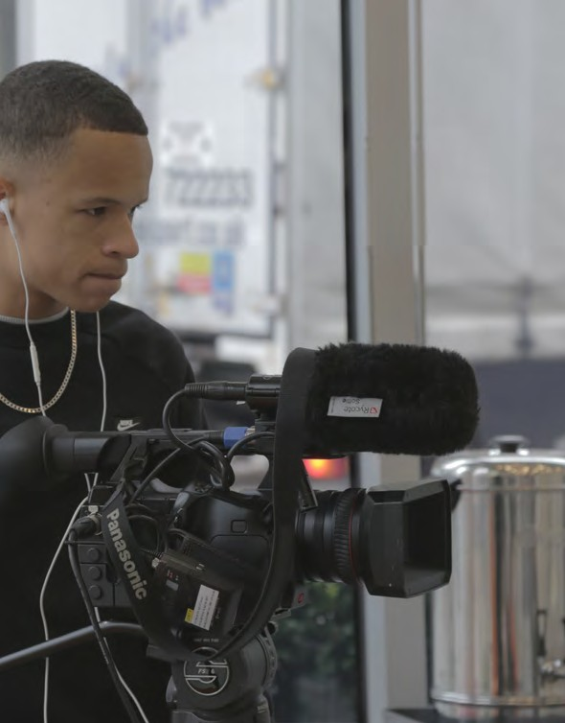
Tamuka
My apprenticeship pushed me further…
I studies a Digital Media Apprenticeship in association with ITN studios. I was a cameraman whilst studying towards my qualification, and after all my hard work, I was offered a full-time tole. Now I’m a cameraman for ITV London, filming interviews and events. My apprenticeship helped push me further in my career by giving me an opportunity to learn from industry professionals in my new role, thanks to my mentor at ITN. Having been raised in London, it’s amazing that I have the change to see what’s happening in my city whilst filming; this gives me a lot of pride.

Slide 26
Impact of Covid-19
Will the gaming industry be affected in the same way as live events?
Notes:
Covid-19 has has a massive negative impact on the UK economy will have impacted, in particular on the creative industries. However some parts have been more adversely affected than others.
Will the situation for gaming be the same as live events?

Slide 27
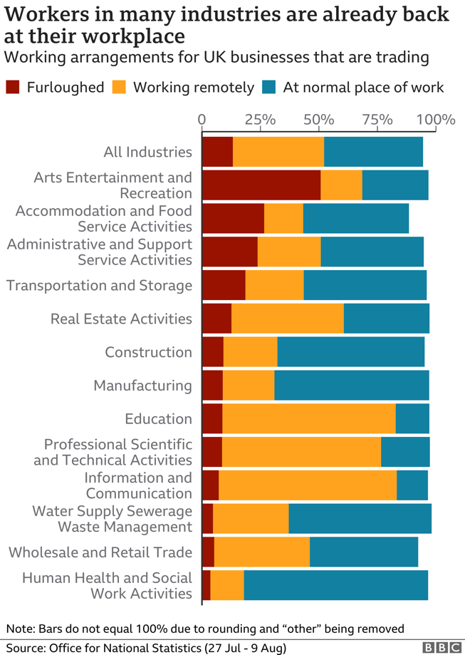
Arts Entertainment and Recreation: Around half of employees still furloughed.
Information and Communication: Far greater percentage of people are able to work.
Notes:
The current working arrangements across a range of industries. Note that overall, very few people are still furloughed. Compare this to the ‘Arts, Entertainment and Recreation’ group which shows that around 50% of workers are still furloughed. This is more than any other group. However the impact of covid is not the same across the culture industry.
https://www.bbc.co.uk/news/uk-53942542

Slide 28
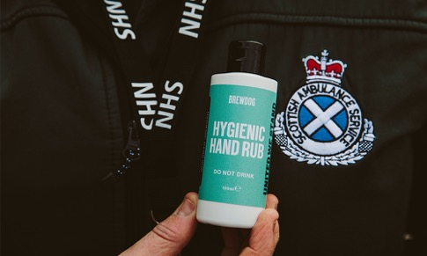


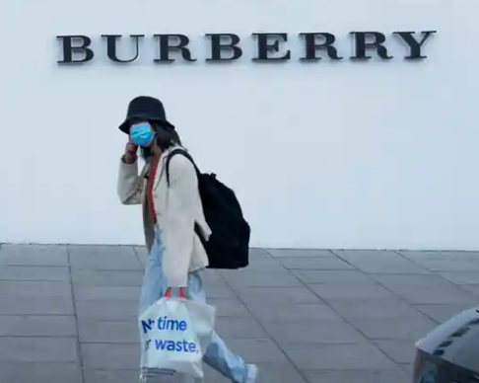


Notes:
All businesses have had to respond to the global pandemic. Here are some examples of their responses.
1. Pivot for Good – where organisations changed their production to help
Alcoholic drinks companies, eg Brewdog making hand sanitizer.
Burberry making PPE
2. Rethinking business model – Where organisations had to adapt and change their offering
Osolocal2u was set up in March 2020 to provide a home delivery service of Fresh Food during the COVID-19 pandemic.
Home deliveries are brought to you by 4DegreesC Ltd, established in 1984. 4DegreesC supply top eateries throughout London and the South East from BRC accredited, refrigerated warehouses in New Spitalfields Market, London and Southampton with a shiny fleet of FORS accredited lorries.
https://www.osolocal2u.com/pages/about-us
3. Virtual world
Virtual museum experiences – Museum of London – Great Fire of London Live Stream
https://www.museumoflondon.org.uk/families/great-fire-london-live-stream
Virtual Museum tours https://www.museumoflondon.org.uk/families/fun-home/virtual-tour-victorian-walk
Meerkat Music – Live stream performances from Take That and Little Mix
Virtual Orchestra – free outreach for young musicians, to give them a chance to play in an ensemble. Started with 60 musicians, now has over 3,500 registered participants across the globe.

Slide 29


What might the recovery of the cultural and heritage sector look like?
£1.57bn
Notes:
Museums and Galleries
There has been gradual reopening throughout the summer. Tate Modern - 70% fewer visitors than before the pandemic distanced through queues, timed tickets.
Performing arts
Lots of possible variations have been suggested: take it outside, downsize it, spread it out, stream it. Could you stage a drive-through opera? Could a composer write a work for a socially distant ensemble? Can you make an online literary festival attractive to audiences when they can’t be in the same room as the authors?
https://www.theguardian.com/commentisfree/2020/may/18/war-arts-stronger-covid-19-devastated-theatres-museums-imagination
It’s clear that the Performing and live arts are suffering more than any other sector, but their value to society is being appreciated all the more by its absence. Therefore it’s essential that the cultural and heritage sector is protected for future generations. In July the government announce a £1.57 billion investment to help to do urgent and critical work secure the survival of the industry.
https://www.artscouncil.org.uk/blog/delivering-governments-culture-recovery-fund
In addition Arts Council England have an Emergency Response Package which they will use to build on the government’s rescue package.
ACE have re-opened National Lottery Project Grants, increasing the budget by £18 million to make £75 million available to individuals, community and cultural organisations.
Developing Your Creative Practice - reopening this to help creatives step up their work in new ways, and increasing the budget from £3.6 million to £18 million.
Plus an extra £2 million to support the work of freelancers in the sector.
https://www.artscouncil.org.uk/covid19
Additional reading
https://www.creativereview.co.uk/landing-page/creativity-in-the-age-of-coronavirus/

Slide 30
Next steps:
Things you can do

Slide 31
How could you demonstrate that you are creative?

Slide 32




Document your creative ouput/experience
Notes:
https://www.arts.ac.uk/__data/assets/pdf_file/0029/62489/Creative-CV-Guide.pdf

Slide 33






What next?
Research
Everything you need to help you plan your future!
Notes:
What areas of the creative industries interest you the most?
Organisations and schemes that can help you take the next steps towards a career in the creative industries
https://www.prospects.ac.uk/jobs-and-work-experience/job-sectors/creative-arts-and-design/creative-jobs
https://discovercreative.careers/

Slide 34
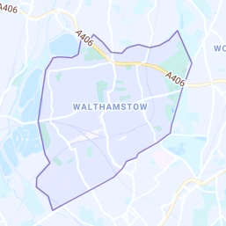






What next?
Local opportunities
Further education, apprenticeships and creative employers in Waltham Forest
Notes:
Further education, apprenticeships and creative employers in Waltham Forest
Waltham Forest College
Leyton Sixth Form College
Monoux Sixth Form College
Future Creatives: Waltham Forest trainees to become the next generation of leaders in the creative world
BCE: The largest creative college in London
LBWF Film Office: The Film Office manages filming and photographic shoots for the London Boroughs of Tower Hamlets, Newham, Enfield, Waltham Forest and Merton (the most film friendly boroughs in the Capital) along with many private locations.

Slide 35

What next?
Mentor
Seek out someone who has had the professional success you would like to have*.
Don’t be afraid, people will be happy to help and flattered that you have asked.
Ask them questions about the decisions that have made.
Ask them for advice on making the right subject choices.
Utilise professional organisations, such as GEM.org.uk or networking sites such as LinkedIn.
* Ask for advice and support from your school / college before approaching a potential mentor.
Notes:
Local mentoring scheme….

Slide 36







What next?
Higher Education and training
Further steps :
How can your school help?
What support do universities offer?
Which companies would you like to work for?
Do they run traineeships or graduate schemes?
What does being self-employed involve?
Find artists you are inspired by
Notes:
University of the Arts Insights Programme: From the famous and renowned to the up and coming and innovative- UAL have collected together different artists and designers or creative approaches for you to explore.
Artswork: Creative apprenticeships
The Apprenticeship Guide: find out more about apprenticeships and search for apprenticeships by sector
Creative Alliance: the specialist provider of creative, digital and marketing apprenticeships.
Give Grad a Go: Give A Grad A Go is a graduate recruitment, jobs and early-career talent community.

Slide 37





What next?
Job Search
Notes:
Follow the links to job search pages for the creative industries
Read some job descriptions:
What jobs appeal to you?
What skills do you need to apply to them?
Do the salaries meet your expectations?
What job could you be doing in 10 years time?
What experience do you need to build to get there?

Slide 38
Summary
Creative subjects train you to think in a way that will be valuable in the world of work
The creative industries are dominant in the future of the UK economy
The opportunities available to you as Londoners and residents of Waltham Forest exceed those of young people in other parts of the country- make the most of them!

Slide 39
Questions

Slide 40
Feedback on Creative Careers Sessions:
What schools say:
"well crafted and very engaging because students know the local context. There is a good mix of practical and informational input so that students are engaged – the resources and questions really make them think.” (Willowfield School)
“very informative of how you can achieve your goals” (William Morris School)
• 20% increase of students keen to study a creative subject (Chingford Foundation School)
• 7 of 16 pupils want to study a technology related creative subject
• the average pupil score increased by 1 scale demonstrating a confirmed increase in their knowledge of Creative Careers
• 86% of pupils said the presentation on Creative Careers was useful to them

